Slide 1

CS654: Digital Image Analysis
Lecture 1: Introduction

Slide 2
Outline
Welcome to the course
Logistics
What is Digital Image Analysis
Application areas
What will be our approach

Slide 3
Logistics
Classroom lectures
Demonstration
Class timings ( Mon, Tue, Wed – 3 PM), @ 2105
Grading policy
Topic | Weightage
Mid sem 1 | 10%
Mid Sem 2 | 15%
Programming assignments | 25%
End Sem | 50%

Slide 4
Logistics (continue)
Approximately 40 lectures
Course website: http://home.iitj.ac.in/~chiranjoy/cs654.html
Approximately 5 programming assignments
Preferable language: Matlab
Reports to be submitted for the assignments (Latex)
Attendance rule of the institute will be followed

Slide 5
Digital Image
A digital image is a numeric representation (normally binary) of a two-dimensional image.
Analysis
Analysis emphasizes an investigation of the problem and requirements, rather than a solution

Slide 6
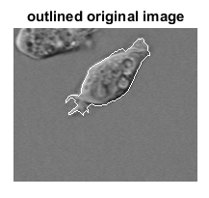
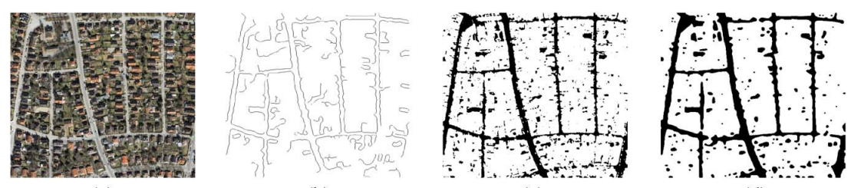
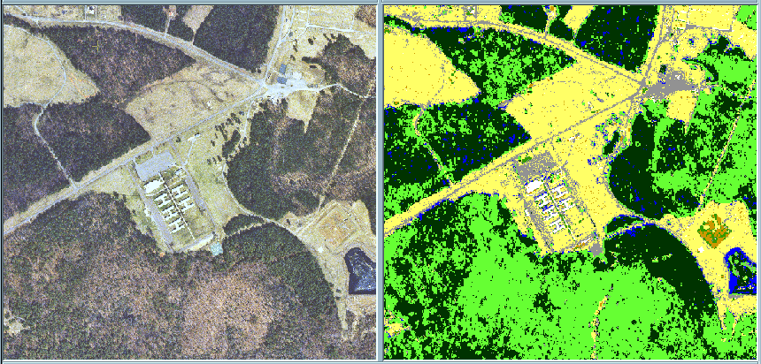
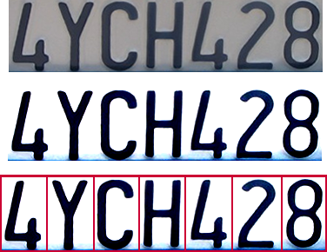
Application of Digital Image Analysis
Das et al. IEEE T-GSRS, 2011
Licence plate recognition
Land Cover Classification

Slide 7
Basic Classes of Problems
Image representation and modelling
Image enhancement
Image restoration
Image analysis
Image data compression
Image inpainting

Slide 8
Image Representation and modelling
Perception
Local
Global
Sampling, Image transforms,
Statistical models, neighbourhood relationships
Segmentation, Clustering, Image understanding

Slide 9
Image enhancement
Accentuate certain image features for further image analysis task or for display
It does not increase the inherent image content

Slide 10
Image restoration
Image restoration refers to the minimization or removal of the known degradations in an image.
De-blurring, noise filtering, correction of geometric distortion etc.
Original image
Blurred input image
Restored image

Slide 11
Image analysis
Making quantitative measurements of an image to produce description of it.
Extraction of certain features that aid in some task.

Slide 12


Image inpainting
Inpainting is the process of reconstructing damaged parts of image.
Input image
Inpainted image

Slide 13
Image compression
Techniques to reduce the number of bits required to store and transmit images without any appreciable loss of information.

Slide 14

Digital images
Y-axis
X-axis

Slide 15
Related field of studies
Image processing
Computer vision
Computer graphics
Pattern recognition

Slide 16
Thank you
Next Lecture: Image Digitization

